Slide 1


Citation Networks Evolution Using Dynamic Network Embeddings
Shay Bistrizky
Avishay Bar
316165984
206622086

Slide 2
Road Map
Introduction
1
2
Motivation
Research Objectives
3
4
Background
Approach
5
6
Model Flowchart
Conclusion
7

Slide 3
Road Map
Introduction
1
2
Motivation
Research Objectives
3
4
Background
Approach
5
6
Model Flowchart
Conclusion
7

Slide 4

Introduction
Significance of Highly Cited Articles
Dynamic Networks and Embeddings
Shaping research priorities, fostering collaboration, and driving innovation.
Use embeddings to track changes, reveal trends, and identify key works.
Static Analysis Limitations
Dynamic Citation Analysis
Limitations in capturing temporal changes, identifying trends, and predicting dynamics.
Classify citation articles through embedding analysis.

Slide 5
Road Map
Introduction
1
2
Motivation
Research Objectives
3
4
Background
Approach
5
6
Model Flowchart
Conclusion
7

Slide 6




Understand Evolution
Rationale
Scholarly fields evolve over time, merging, diverging, and shifting focus. Identifying emerging topics and interdisciplinary collaborations.
Approach
Develop incremental citation graphs with periodic snapshots to visualize how research communities form, merge, or dissolve over time.
Expected Outcomes and Potential
Visualizing the evolution of research topics fosters detection of emerging fronts, supports strategic planning, and highlights “hot topics” for collaboration.

Slide 7
Improve Literature
Rationale
Manual reviews are time-consuming and biased, while automated approaches enhance efficiency and objectivity in knowledge discovery.
Approach
Implement systems that organize citation contexts, track citation trends, and identify connections through structured data analysis.
Expected Outcomes and Potential
Enhanced literature reviews prioritize relevant and substantive citations, leveraging more accurate impact and influence metrics.

Slide 8
Road Map
Introduction
1
2
Motivation
Research Objectives
3
4
Background
Approach
5
6
Model Flowchart
Conclusion
7

Slide 9
Project Objectives
The approach focuses on three interconnected objectives, designed to build a comprehensive understanding of citation networks:
Analyze Citation Networks
Identify Archetypes
Examine structure and evolution over time.
Develop Scalable Model
Analyze node classifications within the citation dynamic network.
Create an efficient embedding model for large-scale analysis.

Slide 10
Road Map
Introduction
1
2
Motivation
Research Objectives
3
4
Background
Approach
5
6
Model Flowchart
Conclusion
7

Slide 11
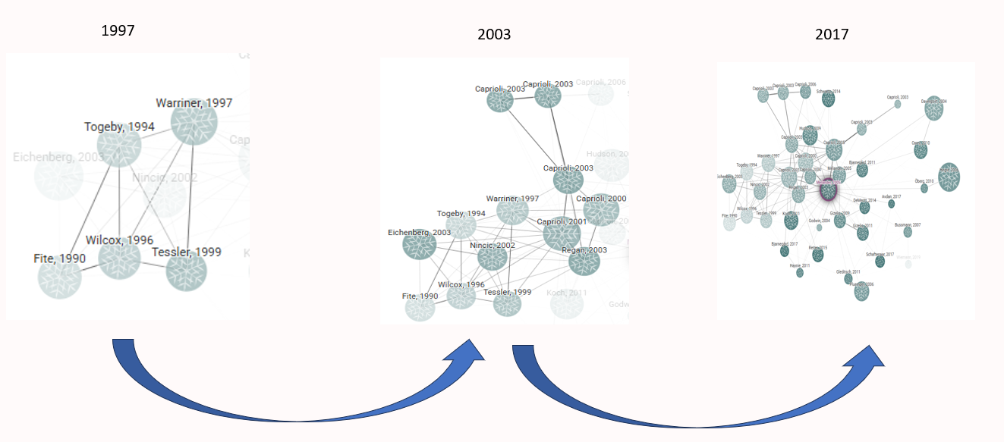
Dynamic Networks
1
Static Networks
2
Dynamic Networks
3
Temporal Changes
Static networks capture connections at a single point in time, lacking the evolution of relationships.
Dynamic networks capture evolving connections over time, showing how relationships change.
Key factors are node proximity and temporal continuity, showing closeness and consistent representation over time.

Slide 12
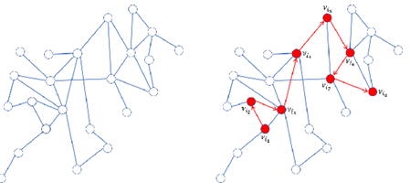
Random Walks for Network Exploration
What is a Random Walk?
Key Advantages
A random walk is a stochastic process that generates a path through a graph. At each step, the next node is chosen randomly from the current node's neighbors.
Enabling efficient sampling of large networks, especially when global computations are impractical or computationally expensive.
Why Use Random Walks?
Random walks are widely used for exploring graph structures, analyzing connectivity, and identifying communities.

Slide 13
Dynamic Bernoulli Embeddings
Dynamic Bernoulli embeddings are a novel approach in dynamic network analysis that aim to preserve the proximity and temporal continuity of nodes in a dynamic network. Dynamic Bernoulli embeddings utilize random walks to generate sequences of nodes.
Random Walk
1
Track the sequential context of nodes within the dynamic network.
Negative Sampling
2
Provides a sample of nodes with negative context.
3
Minimize Loss
Minimize the loss function using the SGD algorithm.
Context Update
4
Updating context vector to each node in the temporal graph.

Slide 14
Road Map
Introduction
1
2
Motivation
Research Objectives
3
4
Background
Approach
5
6
Model Flowchart
Conclusion
7

Slide 15


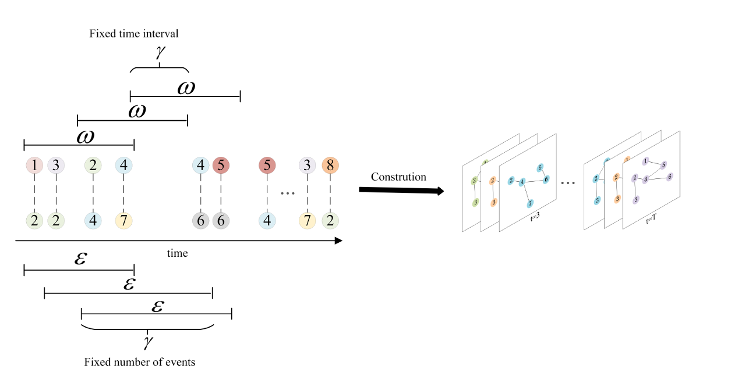
Network Construction
Fixed Time Interval
Fixed Event Count
Create snapshots at regular time intervals, like monthly or yearly.
Construct networks based on a set number of citations, regardless of time.

Slide 16
Citation Dynamic Network Specificities
Irreversibility of Edges
Node Longevity
Citation Burstiness
Citations are permanent and unidirectional, highlighting the enduring impact of foundational works.
Articles remain relevant for years, anchoring the evolving research landscape.
Citations surge with trends, paradigm shifts, or discoveries, highlighting research focus shifts.
Hierarchical Structure of Influence
Field-Specific Dynamics
Citation networks flow hierarchically, with older works as "roots" and newer works building on them.
Citation patterns vary, with fast-evolving fields seeing rapid bursts and others maintaining longer cycles.

Slide 17
Node Classification
Emerging Nodes
Nodes with recently increasing citations
Rising Stars
Emerging nodes with significant growth
Steady Nodes
Nodes with consistent citation activity
Falling Stars
Nodes with declining citation activity

Slide 18
Road Map
Introduction
1
2
Motivation
Research Objectives
3
4
Background
Approach
5
6
Model Flowchart
Conclusion
7

Slide 19
Road Map
Introduction
1
2
Motivation
Research Objectives
3
4
Background
Approach
5
6
Model Flowchart
Conclusion
7

